Slide 1
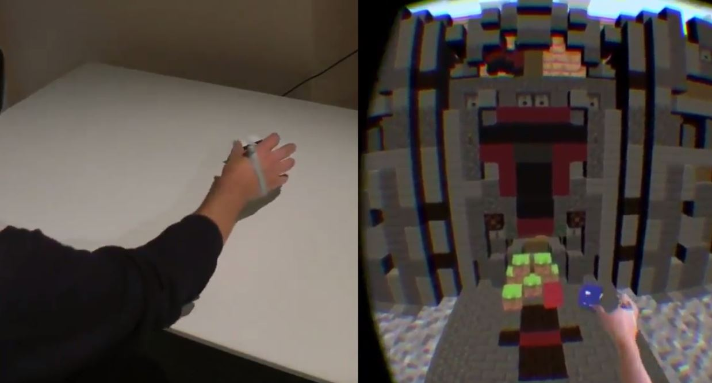
HAPTIC RETARGETING
GRUPPO 9
Dario Doronzo, Davide Trenti, Fabiola Polidoro, Giovanni Forcelli

Slide 2




PROJECT BY
Mahdi Azmandian, Mark Hancock, Hrvoje Benko, Eyal Ofek, Andrew D. Wilson
Microsoft Research Redmond, WA, USA | University of Southern California Los Angeles, CA, USA | University of Waterloo Waterloo, ON, Canada

Slide 3
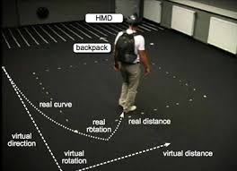
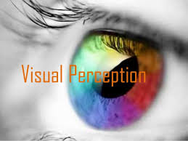
RELATED WORK
HAPTIC & WALKING REDIRECTION | DOMINANCE OF VISUAL PERCEPTION
Sophisticated control mechanisms Latency could be dangerous Expensive | When senses conflict, vision often dominates Vision is also found to dominate proprioception Vision can also dominate vestibular cues

Slide 4
WHAT IS THE GOAL
Reuse physical props to provide a sense of touch
Finding a mapping between the virtual and real coordinates systems
Support interactive manipulations
Not require careful placement or pre-computes positions of the objects
Minimal disturbing to the person

Slide 5
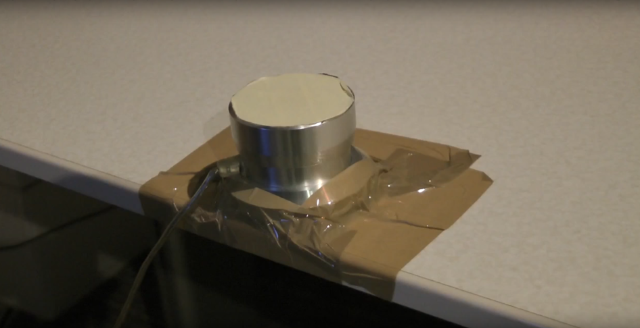
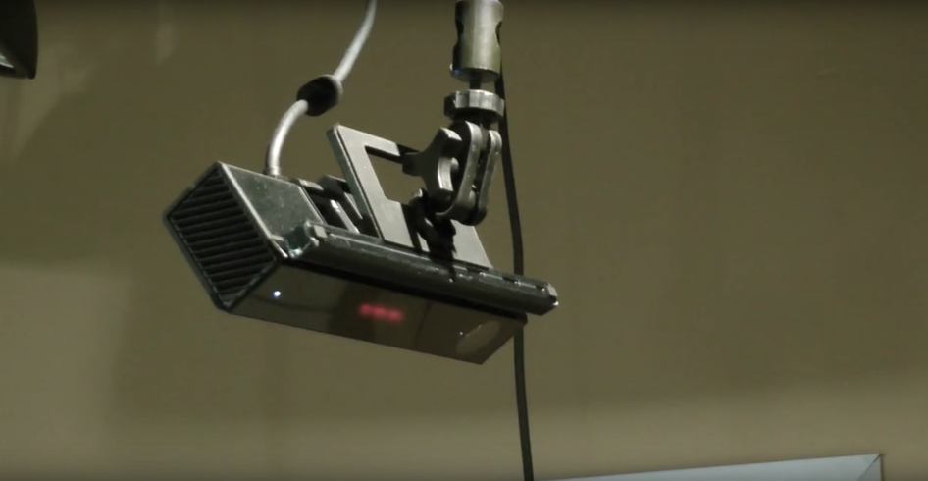
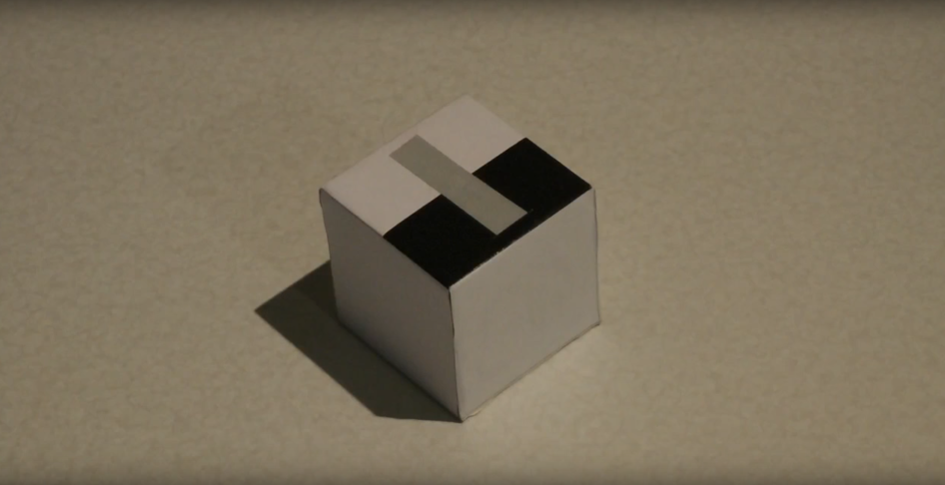
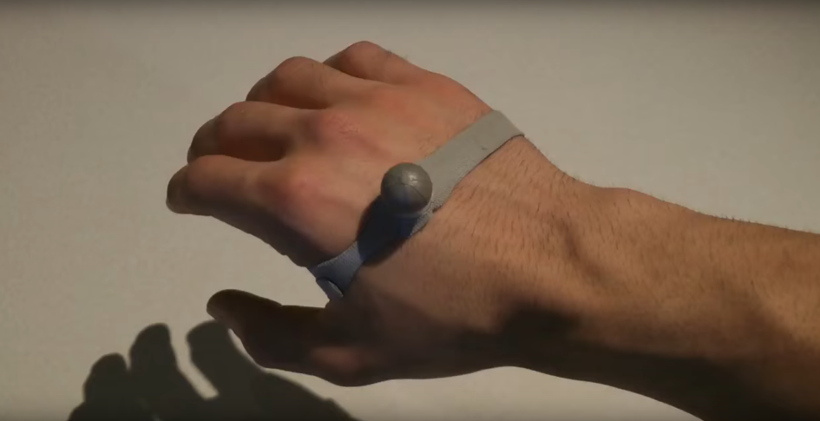
WHAT WE USE
Physic button
Kinect
Tracked cube
Hand marker

Slide 6
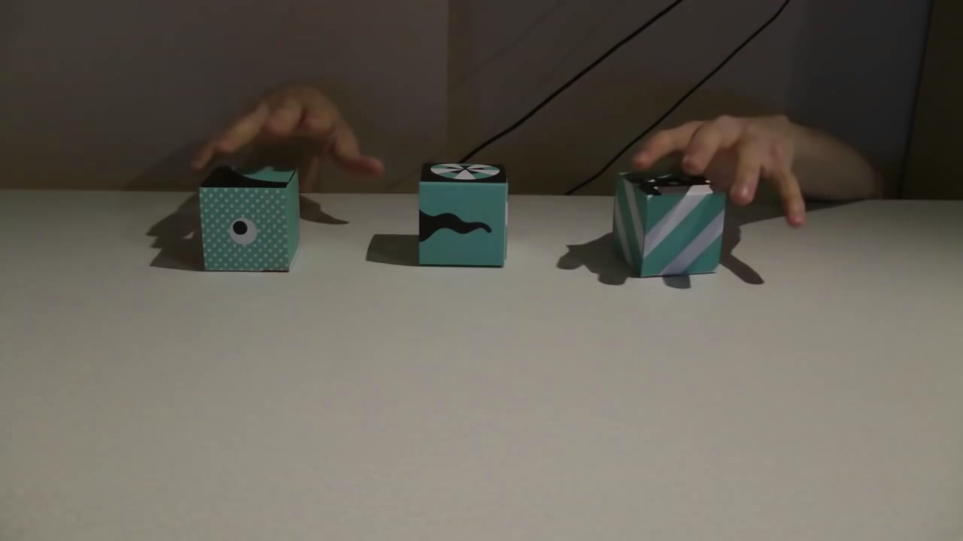
BODY WARPING

Slide 7
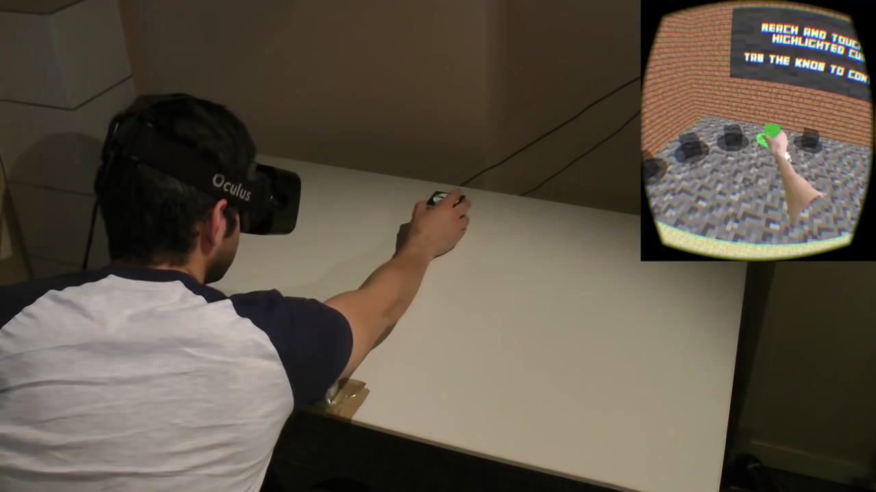
WORLD WARPING

Slide 8
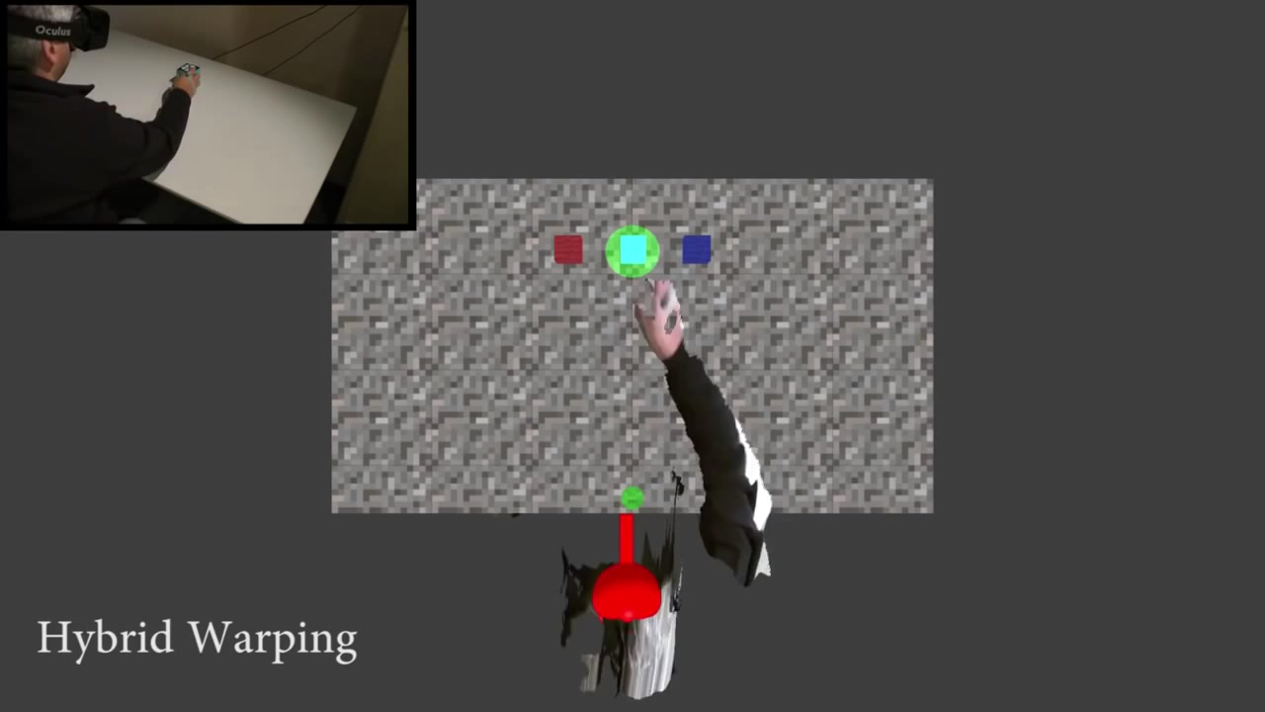
HYBRID WARPING

Slide 9
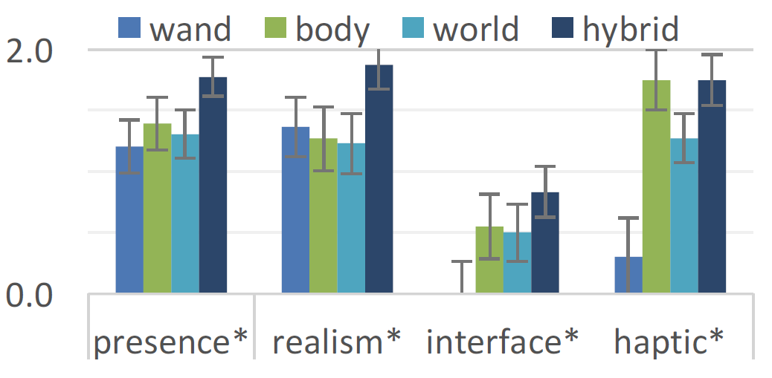
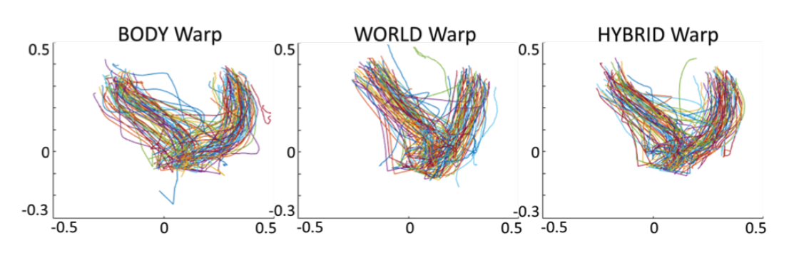
RESULTS
Precence analysis
Precence analysis
Horizontal path

Slide 10
CONCLUSION
Participants reported the highest sense of presence when using Hybrid
Hybrid also had advantages in terms of realism and quality of interface
Path analysis revealed that World had the most direct path
Body led to more corrections near the target object than both World and Hybrid, suggesting that combining techniques can help reduce the need for path correction

